Slide 1
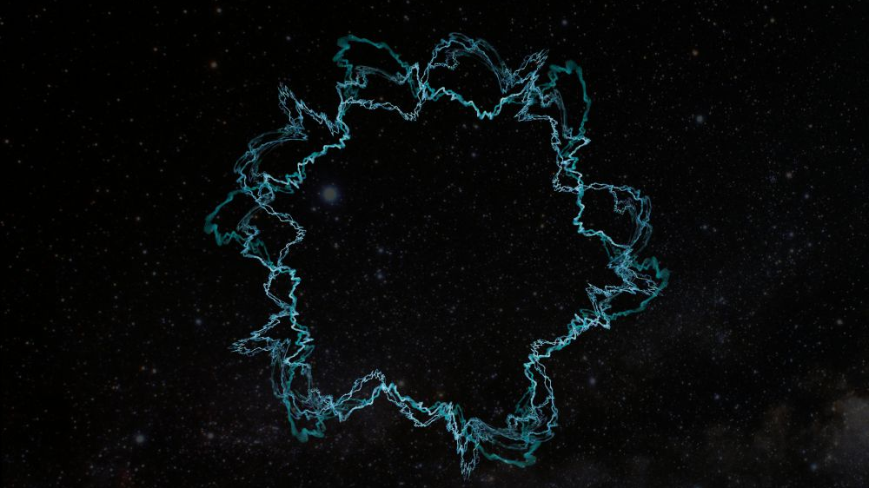
Why is some science not “good” science?
Notes:
In general, science simply is what it is – information obtained through a systematic process. However, it is critically important that the process is maintained so that the information is trustworthy.
Before we start pointing fingers at “good” and “bad” science, let’s talk a bit more about the origins of that process and the term “science” itself.

Slide 2
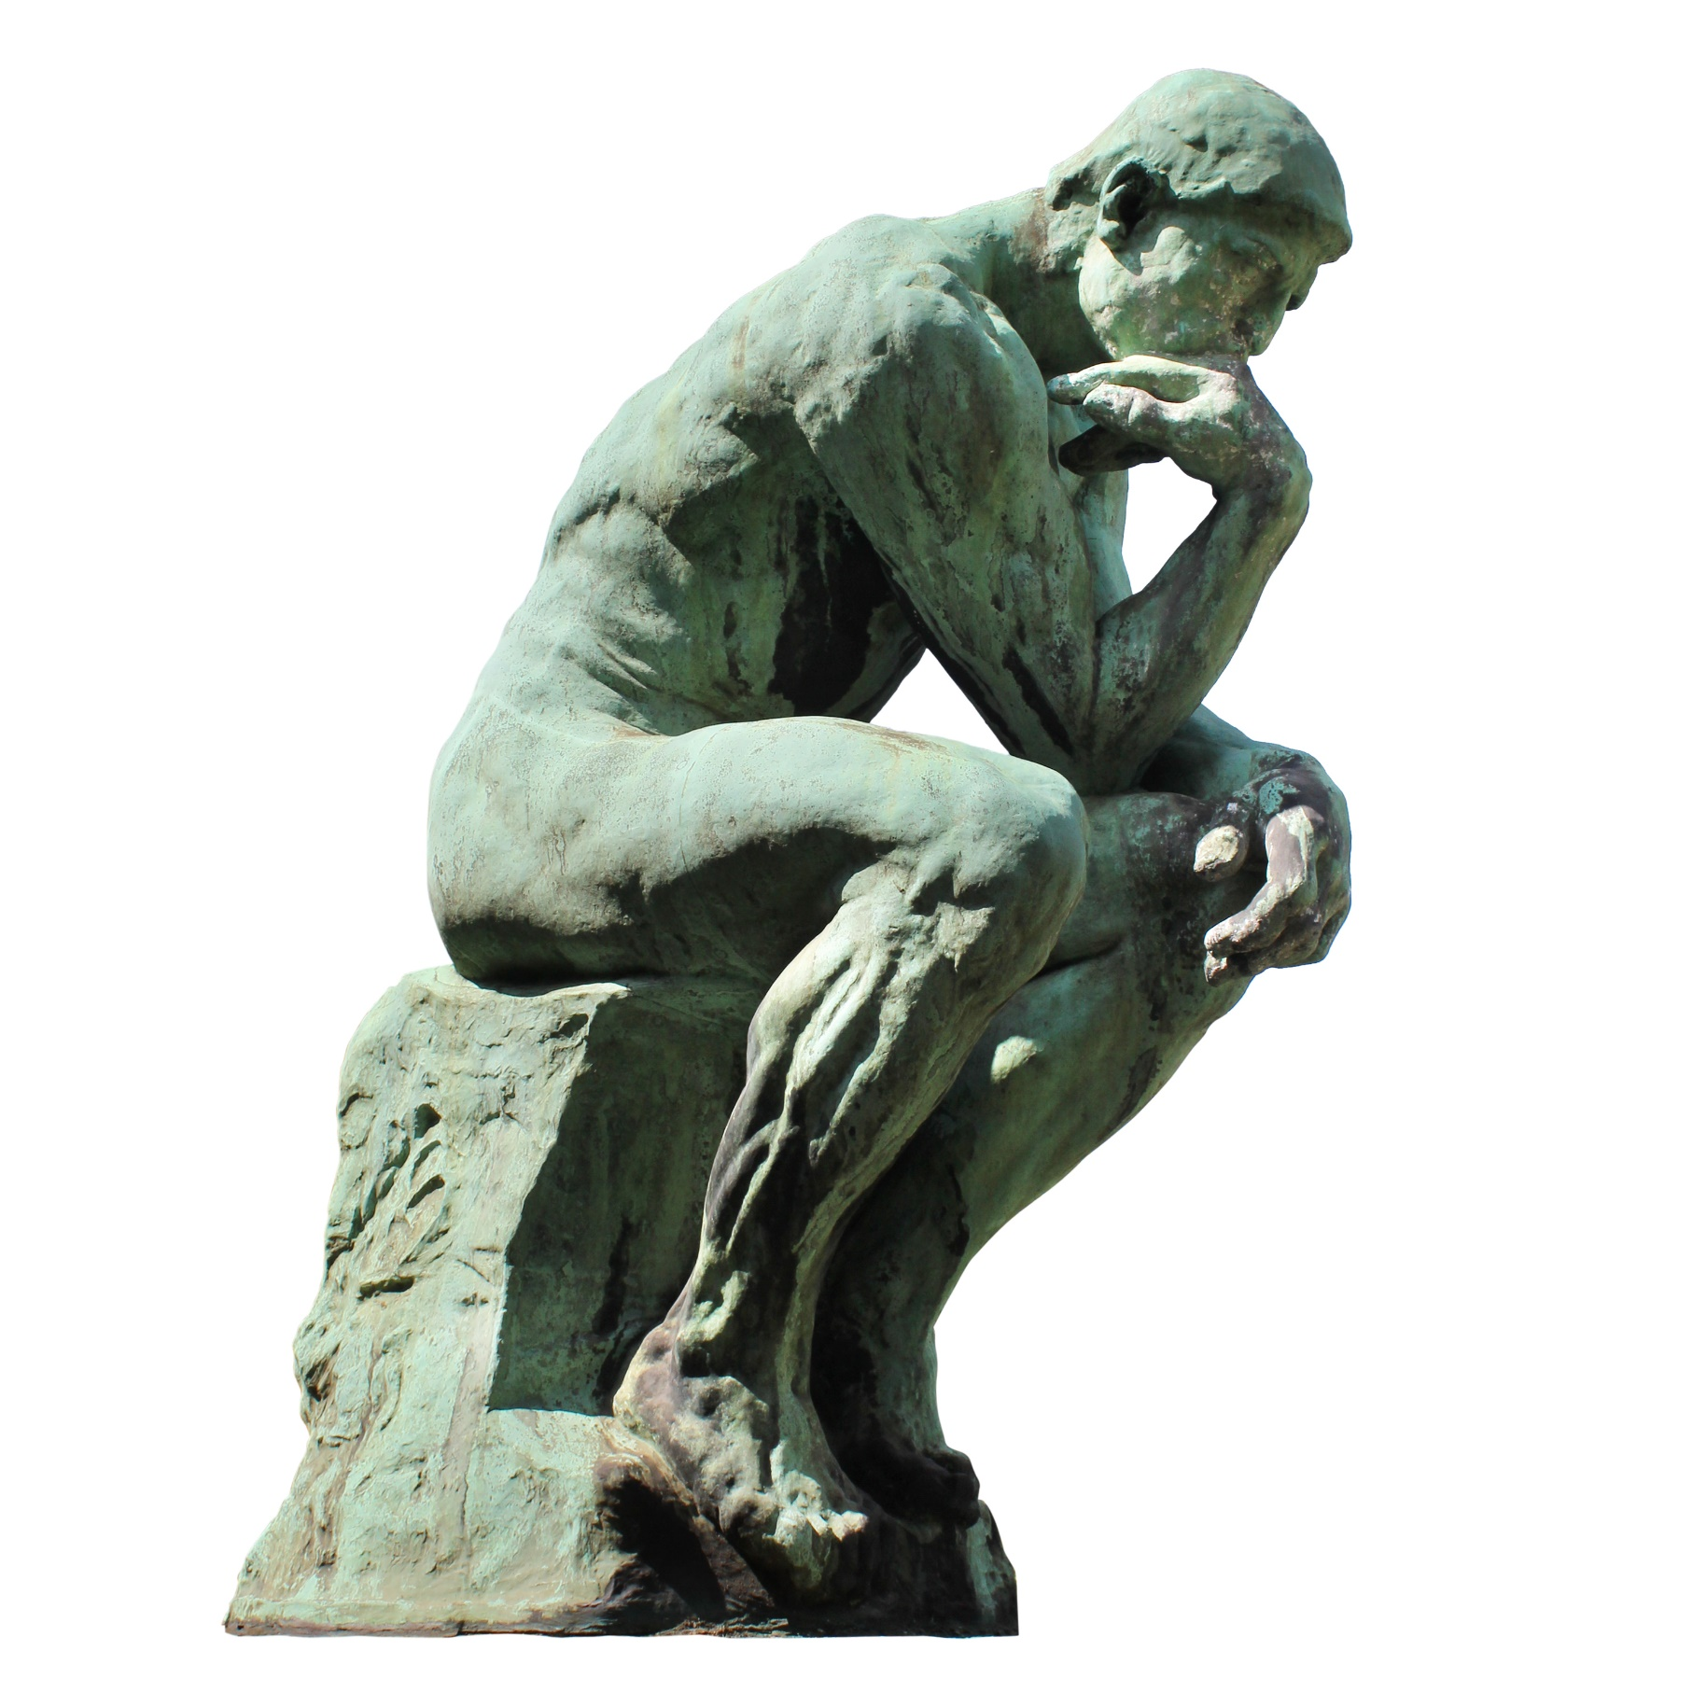
The word “science” entered the English language during the Middle Ages as a French importation synonymous with knowledge.
The sciences were simply specialized branches of philosophy:
Grammar
Logic
Rhetoric
Arithmetic
Music
Geometry
Astronomy
Source: S. Ross, “Scientist: The Story of a Word”, Annals of Science, vol. 18, no. 2, pp. 65 – 85, Jun. 1962.

Slide 3
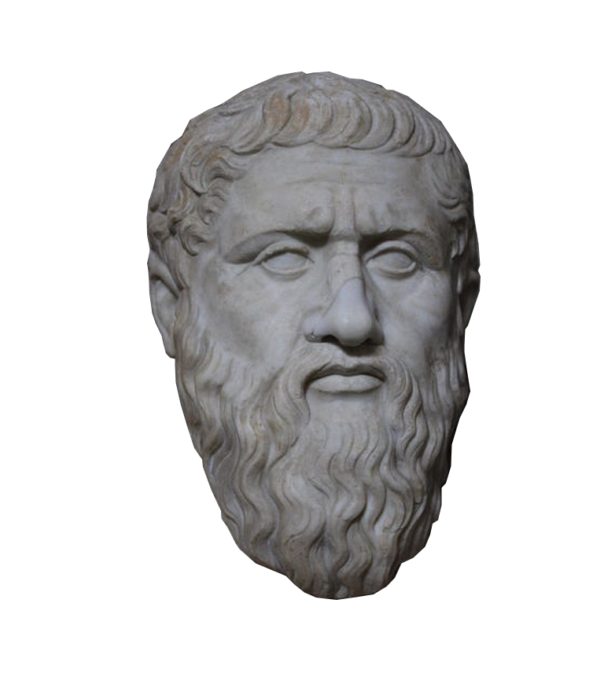
Even though it was initially synonymous with “knowledge”, “science” soon took on its own connotation of systematized knowledge.
The seemingly redundant term “scientific knowledge” took on a meaning of firm, less fallible knowledge than common knowledge.
This originally meant knowledge that had been arrived at by means we would now recognize as belonging to rationalism.
Source: S. Ross, “Scientist: The Story of a Word”, Annals of Science, vol. 18, no. 2, pp. 65 – 85, Jun. 1962.

Slide 4

The number of fields of knowledge expanded during the Renaissance.
These new fields were categorized as natural philosophy, moral philosophy, and metaphysics.
Since knowledge in these fields things couldn’t be reached through inductive reasoning, there was resistance in allowing them to be classified as “science”.
By 1830, with the publication of “Discourse on the Study of Natural Philosophy” by William Herschel, this definition had been relaxed to accept experimental results as “scientific”.
Source: S. Ross, “Scientist: The Story of a Word”, Annals of Science, vol. 18, no. 2, pp. 65 – 85, Jun. 1962.
Notes:
In the 13th century, Grosseteste was advocating experimental “science”, but maintained that “demonstrative” knowledge was not possible in the natural sciences and therefore: “Natural philosophy offers its explanations probably rather than scientifically… only in mathematics is there science and demonstration.”

Slide 5
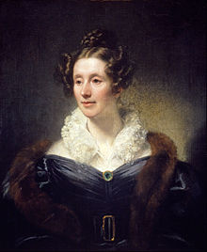
Even as the term physical science began to be used alongside natural philosophy, the term for a practitioner of the sciences was slower to settle.
The term “man of science” was used, alongside names of practitioners of specific fields such as “chemist” and “naturalist” (what we would likely now call a physicist).
The term “scientist” was proposed by William Whewell in a review of On the Connexion of the Physical Sciences by Mary Somerville.
Mary Somerville
(1780 - 1872 CE)
Source: S. Ross, “Scientist: The Story of a Word”, Annals of Science, vol. 18, no. 2, pp. 65 – 85, Jun. 1962.
Notes:
The term was slow to catch on. The ideal practice of science was seen as a noble pursuit of recreation for educated amateurs. Calling themselves “scientists” reduced their pursuit to a profession (like a dentist, pediatrist, etc.), which was not seen as noble.
Michael Faraday liked the term “scientist” but disliked the term “physicist” (he said it had too many “i” sounds in it and didn’t roll off the tongue like “physicien” did in French.
People could be very petty and particular about things like titles, but in the end, “scientist” eventually stuck, “science” was no longer a part of philosophy, and Mary Somerville proved that anyone could be a scientist.

Slide 6
So what makes “good” science?

Slide 7
What is this a picture of?
This is an artists rendering of a string, a major component of the theoretical framework of so-called “String Theory”.
These frameworks attempt to unify quantum physics and general relativity under a single mathematical model. In these models, all particles in the universe are said to be comprised of one-dimensional strings vibrating in multi-dimensional spacetime. These models rely upon large numbers of extra dimensions beyond the typical 4 dimensions of general relativity – 10, 11, and 26 dimensions are proposed by variations of the model.
So, is this “bad science”?

Slide 8
Hypothesis –
A prediction based on a proposed relationship between independent and dependent variables. A good hypothesis should be simple, clear, and, most importantly, testable (falsifiable).
Theory –
A hypothesis or collection of related hypotheses that has held up to experiment numerous times and makes accurate predictions about future observations.
Model –
A theoretical or mathematical framework that describes observations. A model can be part of an established theory, represent an untested hypothesis, or be a hypothesis that holds true in some, limited circumstances, but has limited applicability outside those circumstances.
Notes:
What about a law?

Slide 9
“Good science” becomes “bad science” when:
The author is overly biased toward their hypothesis.
The author clings to a hypothesis that has not held up to experiment.
The author claims something has been “proven”.
The author tries to pass off an untestable hypothesis as something that it is not.
The author misrepresents the scope of what has been tested by experiment.
The model proposed in String Theory is neither “good science” nor “bad science” – it is just currently untestable.
Notes:
Remember Democritus and the atom? That hypothesis was largely untestable for thousands of years.

Slide 10
Alternative Hypothesis –
A prediction based on a proposed relationship between independent and dependent variables. An experiment should be devised to test one or more alternate hypotheses against the…
Null Hypothesis –
A prediction based on the assumption that there is no relationship between the independent and dependent variables in question. This is seen as the “default state”.
The goal of all experiments is to test alternate hypotheses to see if they stand up to empirical evidence better than the null hypothesis does.
A hypothesis is never proven! We either reject the null hypothesis in favor of an alternative hypothesis, or we fail to reject the null hypothesis. Either result is a successful experimental outcome!

Slide 11
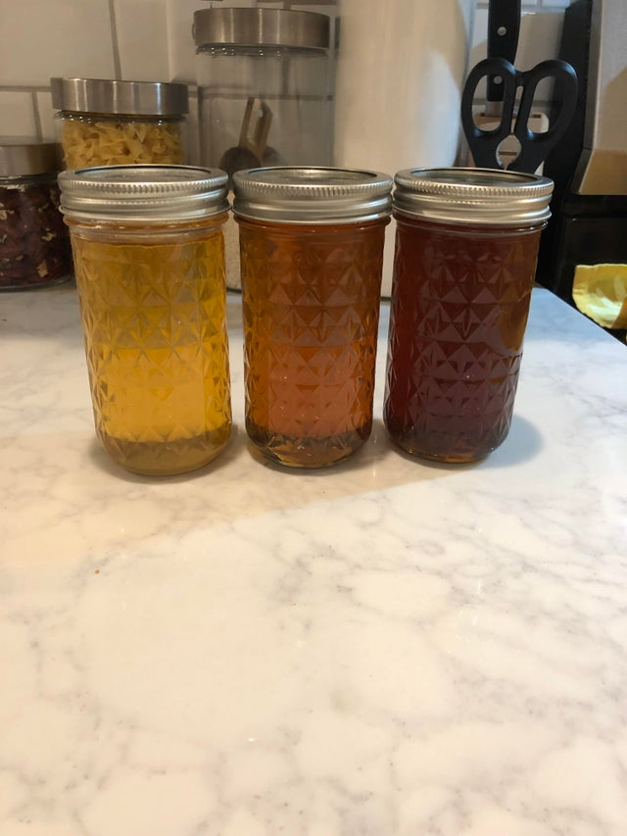
Variations in Honey Color
A Case Study in Experimental Language

Slide 12
“The different colors of the honey I harvested this year: spring, summer and fall.”
Posted to /r/mildlyinteresting by /u/Zig-Zag on September 24th, 2019
Notes:
Notice that, in the title of this post, the author makes no claims about a cause or scope of this “experiment”.

Slide 13
Review
Independent Variable
Dependent Variable
– A factor which isn’t affected by any other variables in the experiment.
Independent variables are typically something which you control.
– A factor which is affected by other variables in the experiment.
Dependent variables are typically something which you measure.

Slide 14
Review
Independent Variable
Dependent Variable
– A factor which isn’t affected by any other variables in the experiment.
Independent variables are typically something which you control.
– A factor which is affected by other variables in the experiment.
Dependent variables are typically something which you measure.
Controlled Variable
Experimental Variable
An independent variable which is purposefully kept constant throughout an experiment.
An independent variable which you change in order to test your hypothesis.

Slide 15
What are our relevant independent and dependent variables here?
Posted to /r/mildlyinteresting by /u/Zig-Zag on September 24th, 2019
Notes:
Notice that, in the title of this post, the author makes no claims about a cause or scope of this “experiment”.

Slide 16
Classifying Variables
Categorical Variables are variables which have discrete or qualitative values. They may be further classified as:
Nominal Variables, which have no discernable numerical value (i.e. cannot be ordered or ranked).
Dichotomous Variables, which have only two possible values (e.g. Yes or No).
Ordinal Variables, which have a discernable numerical value (i.e. can be ordered or ranked).
Continuous Variables are variables which have a range of quantitative values. They may be further classified as:
Interval Variables, which exist along a continuum which does not begin at 0.
Ratio Variables, which begin at 0 and thus can be compared in a ratio.

Slide 17
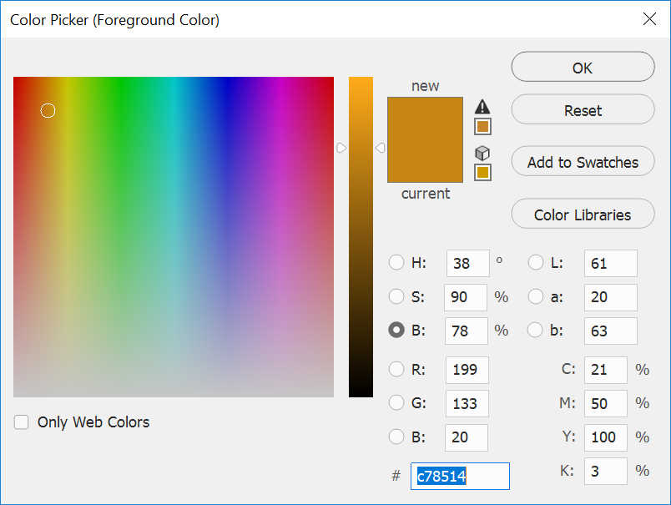

Is our dependent variable categorical or continuous? Can we further classify it?
Posted to /r/mildlyinteresting by /u/Zig-Zag on September 24th, 2019

Slide 18
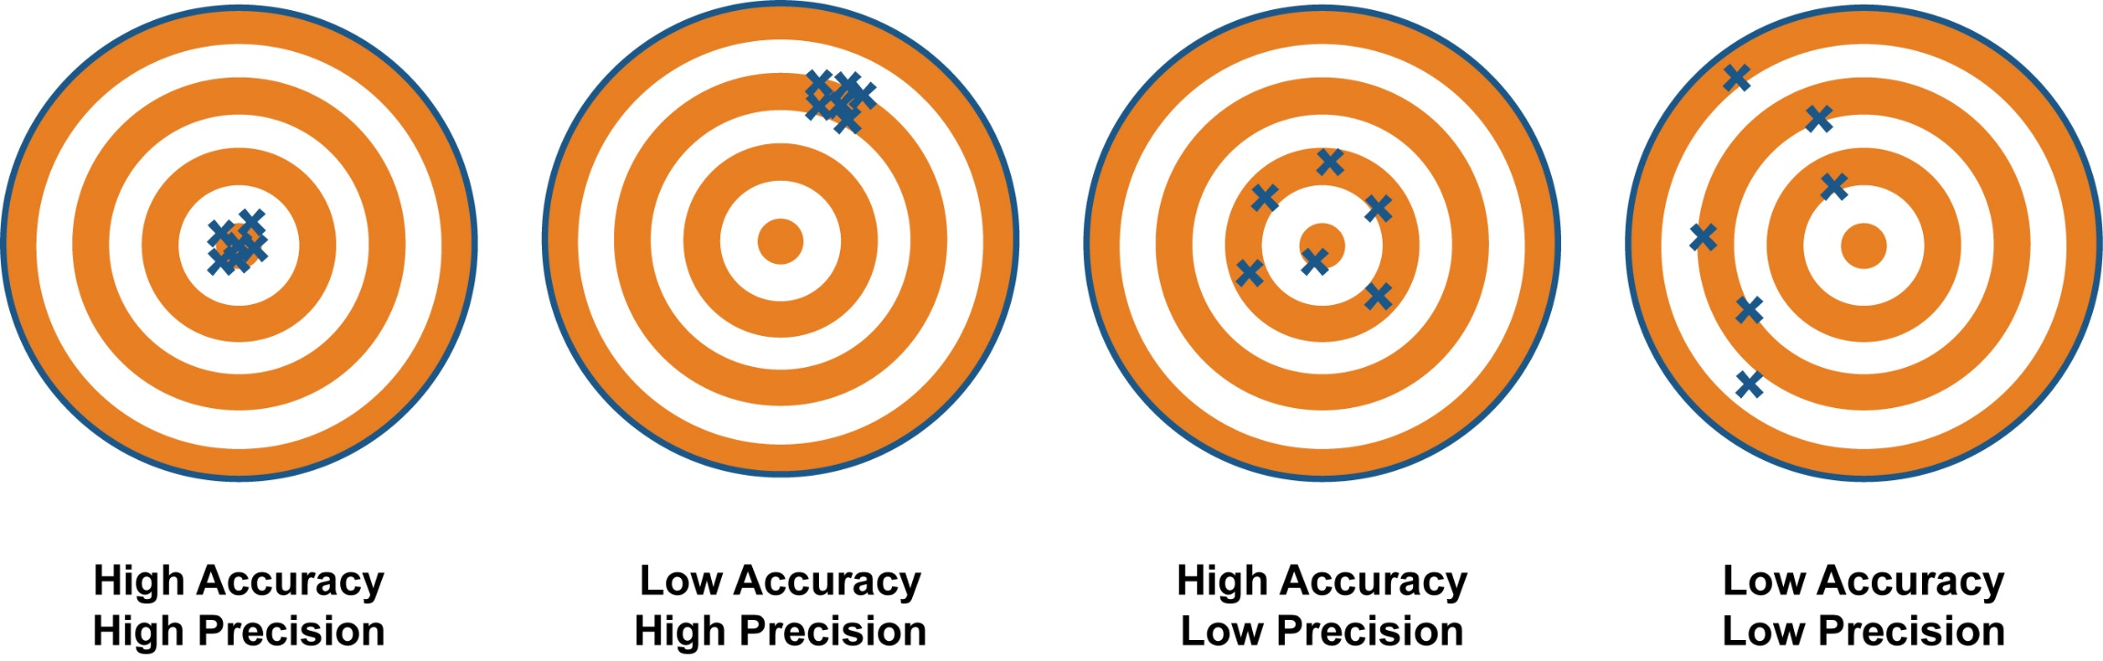
Instrumentation Precision vs. Accuracy
Accuracy is how close a measured value is to the actual (true) value.
Precision is how close the measured values are to each other.

Slide 19
Which one of these represents a low accuracy photo? Which is low precision?
Low Accuracy
Low Precision

Slide 20
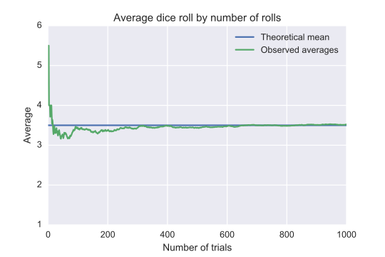
Law of Large Numbers
As the number of trials increases, the central tendency approaches the expected value.

Slide 21
Central Tendency
In statistics, a central tendency is a central or typical value for a random distribution. The three most common measures of central tendency are:
Arithmetic Mean
Colloquially referred to as the “average”. Sum of all values divided by the number of values.
Median
The middle value in a list arranged from smallest to largest.
Mode
The value which occurs the most frequently.

Slide 22
When to Use Central Tendencies
Type of Variable | Best Measure of Central Tendency
Categorical: Nominal | Mode
Categorical: Ordinal | Median
Continuous: Interval or Ratio (not skewed or containing wild outliers) | Mean
Continuous: Interval or Ratio (skewed or containing wild outliers) | Median
Notes:
Mean is an appropriate central tendency when your data has a discernable numerical value, contains a continuous range of values, and does not contain any wild outliers.
Median is an appropriate central tendency when your data has a discernable numerical value, but is not continuous, is skewed, or contains outliers.
Mode is appropriate when your data does not contain a discernable numerical value or is not continuous.

Slide 23
Since we are dealing with a continuous ratio variable, I chose a mean as a central tendency.
Posted to /r/mildlyinteresting by /u/Zig-Zag on September 24th, 2019
Notes:
This helps reduce random error from our instrumentation (camera). It does not account for random variation caused by confounding variables or systematic error of any kind.

Slide 24
Year 1
Alternative Hypothesis:
“The honey produced by bees gets darker in color from spring to fall.”
Spring
Summer
Fall
Null Hypothesis:
“There is no relationship between time of year and the color of honey that bees produce.”
Notes:
This would be “bad science” if we stopped here! All we have proven thus far is that it happened once! We have not tested this hypothesis.

Slide 25
Year 1
Alternative Hypothesis:
“The honey produced by bees gets darker in color from spring to fall.”
Spring
Summer
Fall
Year 2
Null Hypothesis:
“There is no relationship between time of year and the color of honey that bees produce.”
Spring
Summer
Fall
Year 3
If these were our results, we could fairly safely reject our alternative hypothesis with little further analysis.
Spring
Summer
Fall

Slide 26
Year 1
Alternative Hypothesis:
“The honey produced by bees gets darker in color from spring to fall.”
Spring
Summer
Fall
Year 2
Null Hypothesis:
“There is no relationship between time of year and the color of honey that bees produce.”
Spring
Summer
Fall
Year 3
If these were our results, may be able to reject the null hypothesis in favor of our alternative hypothesis, although further statistical analysis would be needed to determine our confidence.
Spring
Summer
Fall

Slide 27
Year 1
What have we demonstrated here?
Even if these results held up to a statistical analysis, they apply to:
This specific colony of bees…
In this specific region.
Furthermore:
We have not determined any cause, just a correlation between time of year and color.
Spring
Summer
Fall
Year 2
Spring
Summer
Fall
Year 3
Spring
Summer
Fall

Slide 28
How can we address these limitations?
Even if these results held up to a statistical analysis, they apply to:
This specific colony of bees…
In this specific region.
Furthermore:
We have not determined any cause, just a correlation between time of year and color.
Test several neighbors’ honey as well.
Randomly select bee colonies from other regions to test.
Create controlled environments where you test:
Type of flowers the bees have access to.
Temperature.
Length of day.

Slide 29
External Validity –
How broadly applicable are the results of this experiment? I.e. can they be applied to the “real world”?
Internal Validity –
How free of “confounding variables” were your experimental conditions? I.e. how confident are you that you had full control over the experiment and can trust its outcomes?

Slide 30
How can we address these limitations?
Even if these results held up to a statistical analysis, they apply to:
This specific colony of bees…
In this specific region.
Furthermore:
We have not determined any cause, just a correlation between time of year and color.
Increases External Validity
Test several neighbors’ honey as well.
Randomly select bee colonies from other regions to test.
Increases Internal Validity
Create controlled environments where you test:
Type of flowers the bees have access to.
Temperature.
Length of day.

Slide 31
Summary: When “Good” Science Goes “Bad”
The author is overly biased toward their hypothesis.
The author clings to a hypothesis that has not held up to experiment (a.k.a. making excuses).
The author claims something has been “proven”.
The author tries to pass off an untestable hypothesis as something that it is not.
The author misrepresents the scope of what has been tested by experiment.
Claiming a hypothesis is a theory, a theory is a law, etc.
Extrapolating results beyond the external validity of the experiment (making too broad of claims).
Overestimating the internal validity of the experiment (overconfidence in causation).
Overstating (or understating) the certainty of an experimental outcome.
Notes:
Most of these can be addressed simply by being a conscientious scientist using only the information we covered today. However, we will spend most of the rest of this course developing our ability to handle this last point.

Slide 32
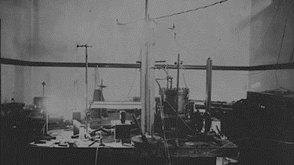
Next time…
Outliers, variation, and descriptive statistics.

